Slide 1
Quantathon
Flight Plan
By Team Stochastic Woods: Qiqi, Nayeon, Neo, Anna

Slide 2
You should not be giving money to undergrad students…
Notes:
Let’s start off with… however, here’s what we would do:

Slide 3
STEPS WE TOOK
BRAINSTORM AND RESEARCH
ANALYSIS AND CONCLUSIONS
TRADING STRATEGY
1. Define Problem
2. Metrics?
1. Clean Data
2. Compare Variables
3. Linear Regression
4. Drew Conclusions
1. Applied Conclusions
2. Tested Against Metrics

Slide 4
Brainstorm and Research
Problem:
Finding the best strategy for investment.
Metrics:
Profit compared to investing in only
MONEY MARKET.

Slide 5
Insights and Analysis

Slide 6
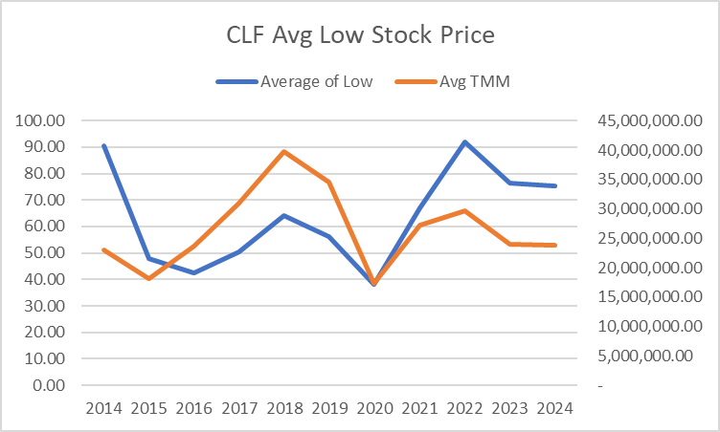

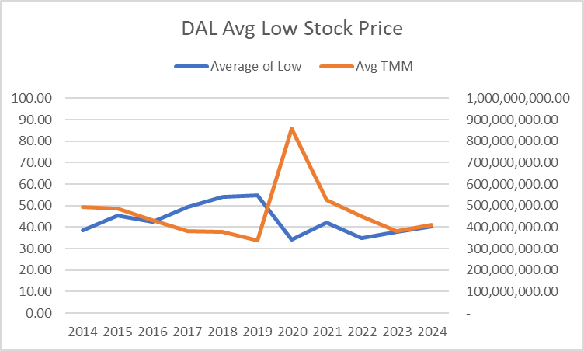
Delta is more price sensitive
Oil stock price is more volatile, but volume is about constant.

Slide 7
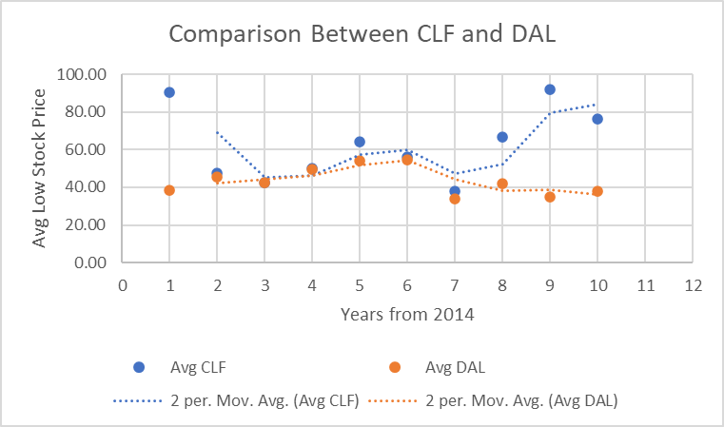
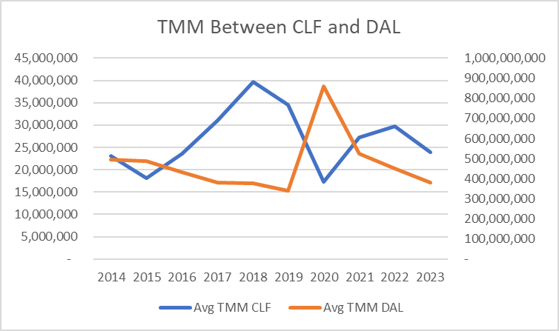
Delta: October 10, 2016?

Slide 8
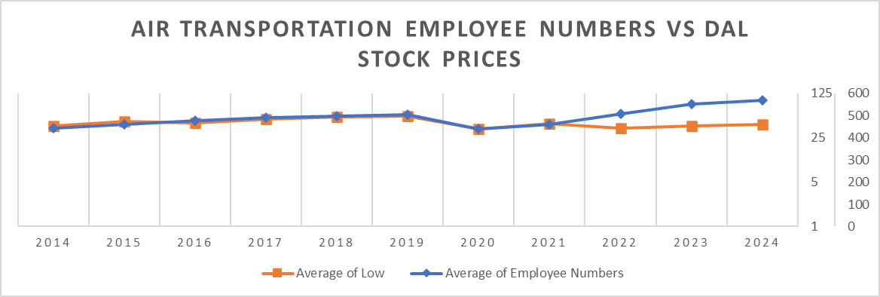
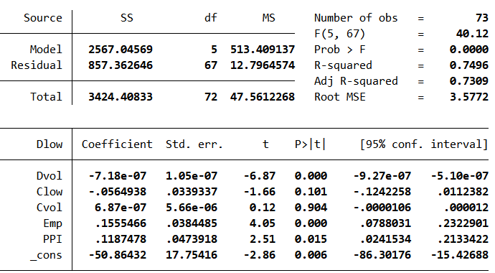
Pre-Covid_Monthly (Before March 2020)
Employee numbers have been shifted right by a quarter to account for delay from reports to action
Thousand of person

Slide 9
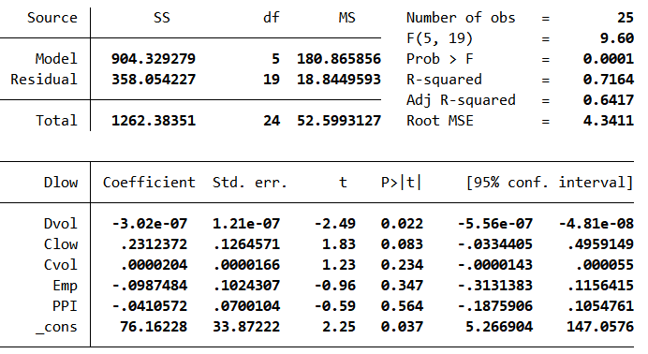
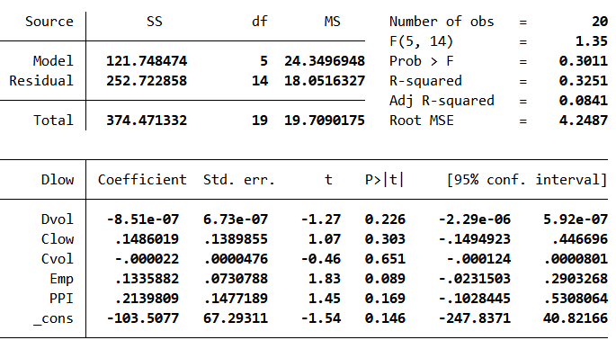
During Covid_Monthly (April 2020-April 2022)
Post-Covid_Monthly (After May 2022)
Notes:
Once covid hit, all of that went out the window.

Slide 10
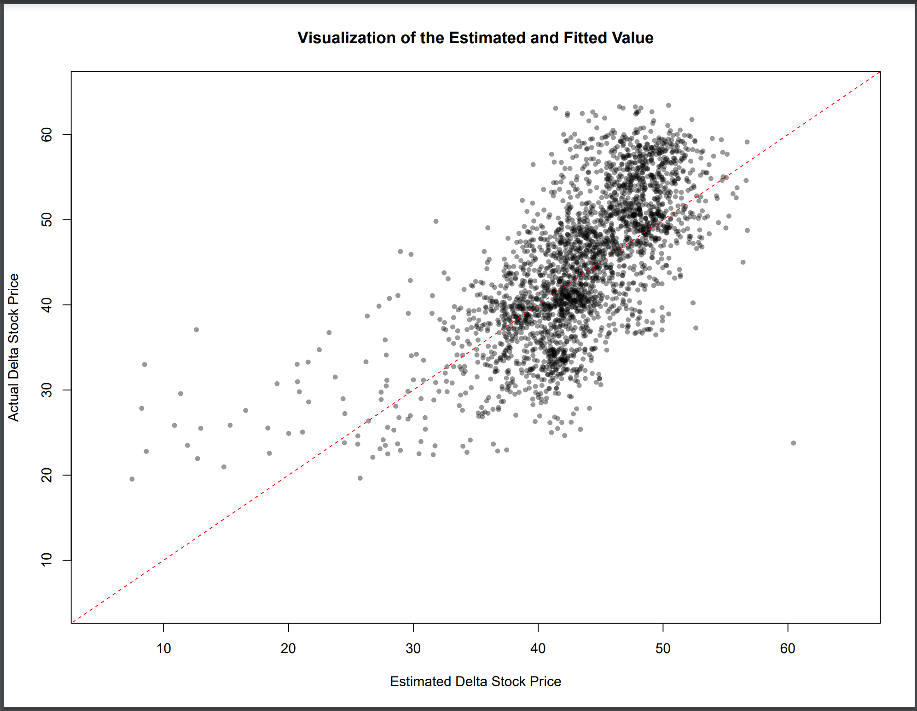
Linear Regression
[Delta Stock Price]
= 47.974
- .0779 * [Oil Price per Barrel]
- .0005 * [Traded Delta Volume] / 10^3
+ .0126 * [Traded Oil Volume] / 10^3
+ [error]
Fit of line ->

Slide 11
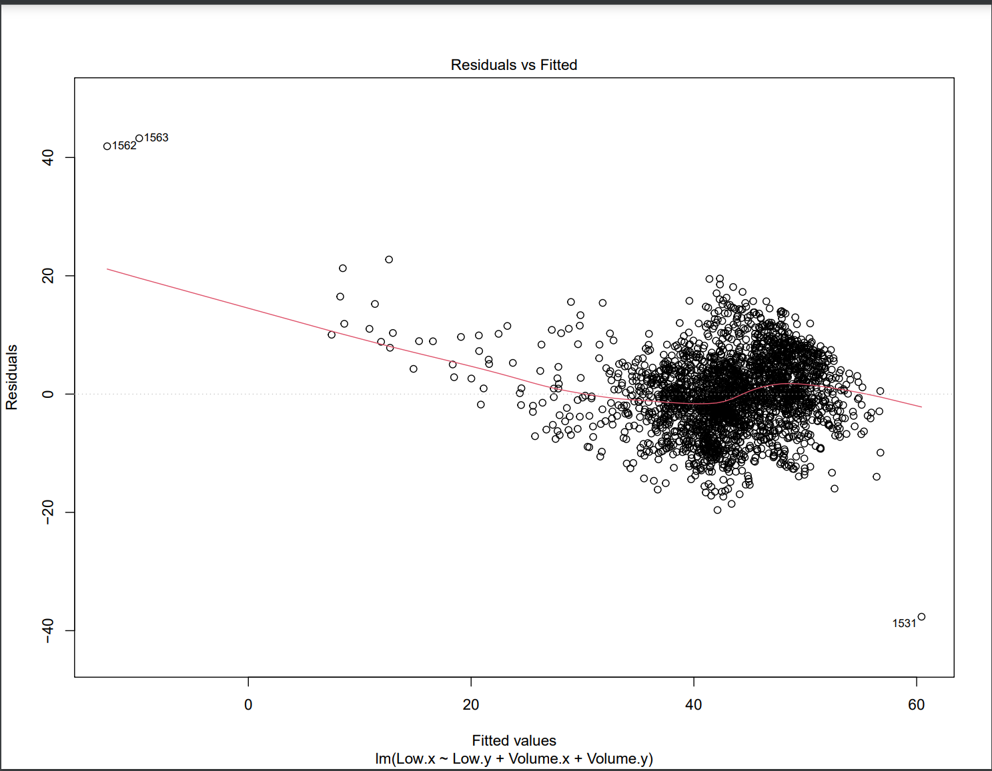
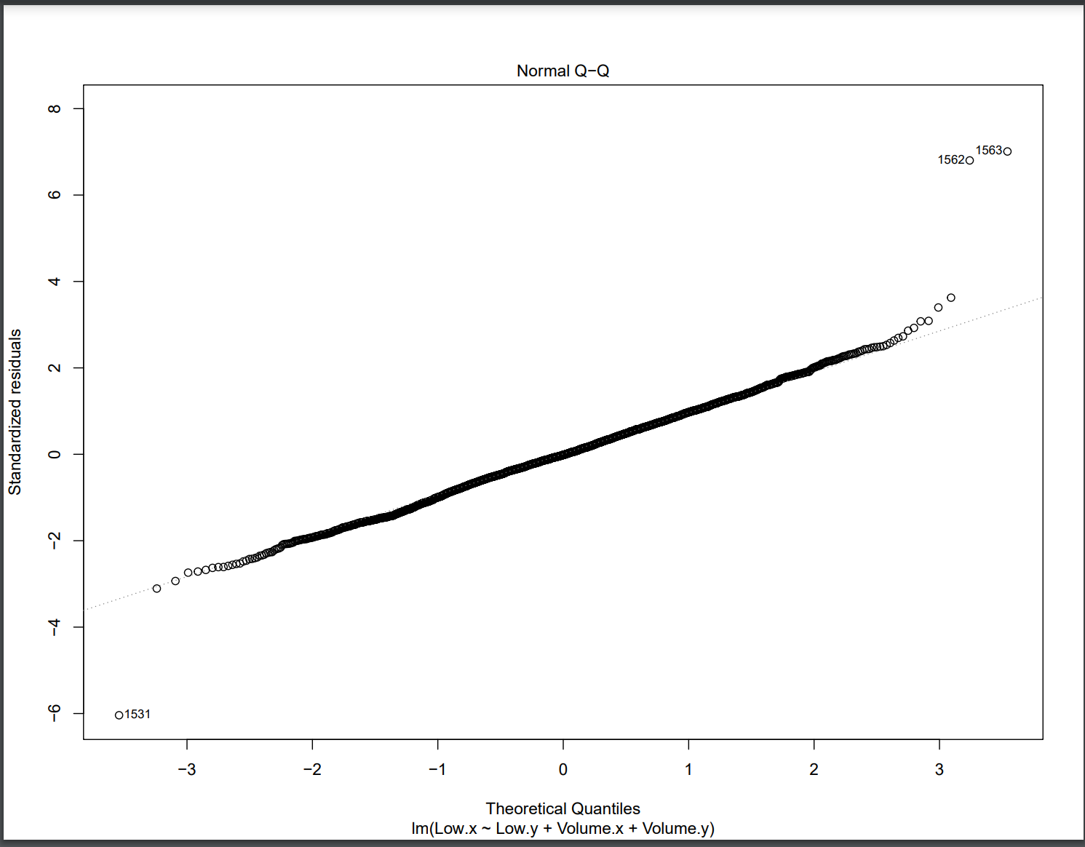

Slide 12
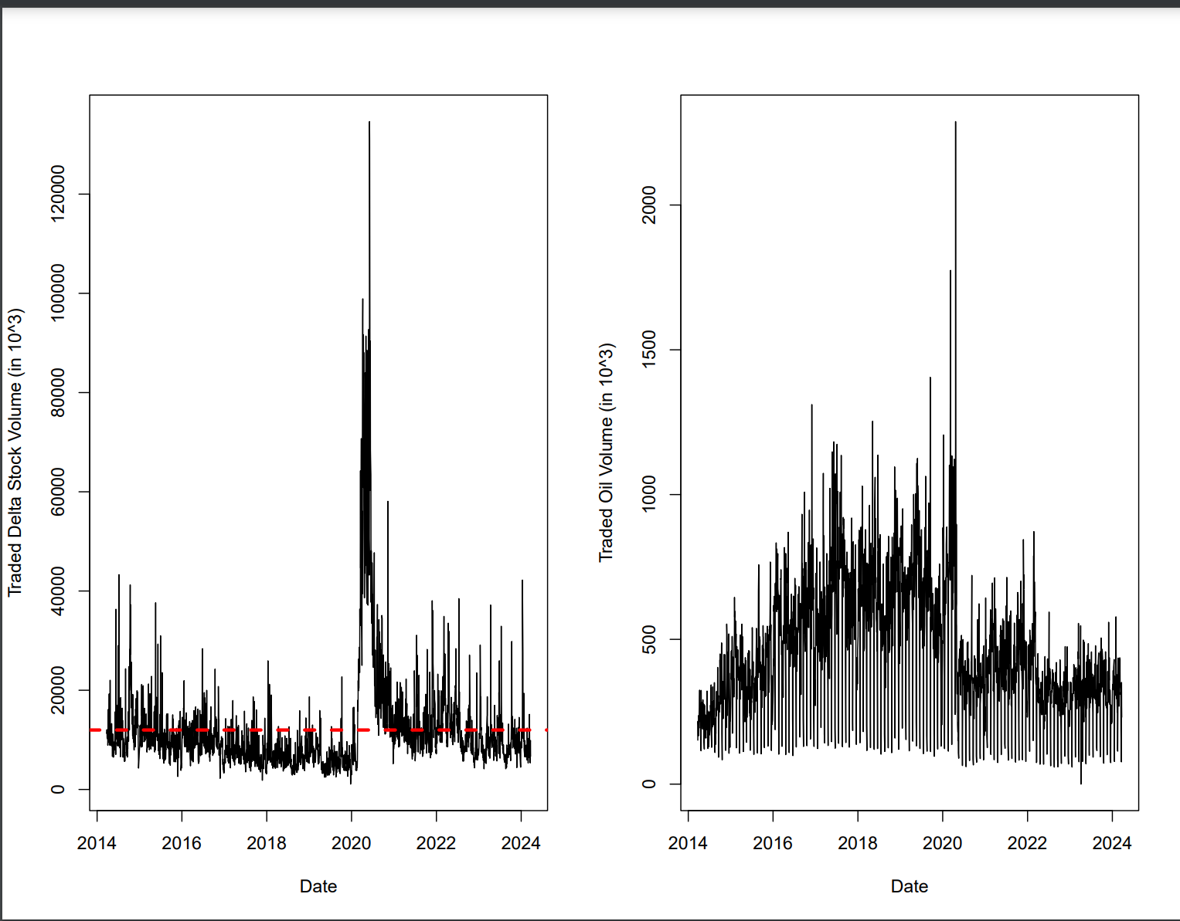

Slide 13
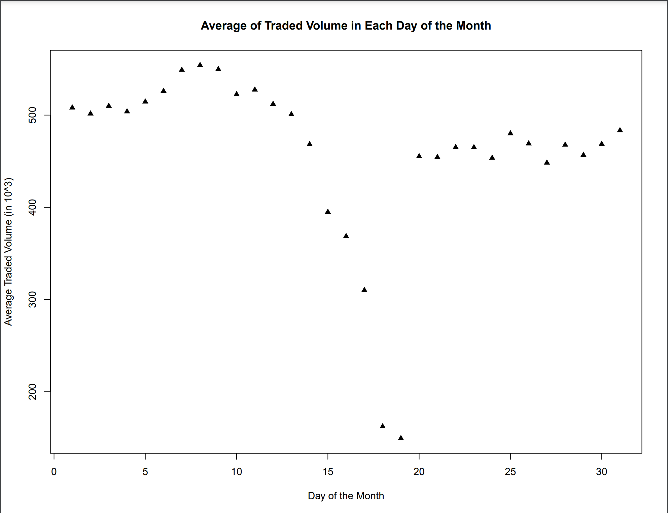

Slide 14
1. Peak
Trading Strategy
Main Rules
2. Often
3. Money Market
Decreasing: Buy
Increasing at rate <5.27%: Sell
Increasing at rate >5.27%: Rapidly buy and sell
Buy and sell as often as possible to reinvest. A.k.a. Rebalance each month
Stock price increasing rate <5.27%: Invest money into money market

Slide 15
More General Trading Rules
Action
Employment
Sell and buy on Wednesday near 10th or earlier of each month.
Sell stocks within lower quartile of price for that day.
Delta stock prices tended to correlate with pre-covid air transport employment patterns that happened.

Slide 16
Model Performance
$16,712.69
$ 183,512,573.00 +
Tossing $10,000 into the money market
Utilizing our trading methods, mature in 10 years.

Slide 17
Further Explorations
What we would have liked to look into given we had more time on our hands.
Notes:
-Analyze seasonality of delta
-Explore fitting data to time series

Slide 18
Bibliography
All employees, Air Transportation. FRED. (2024, March 8). https://fred.stlouisfed.org/series/CES4348100001
Producer price index by industry: Scheduled Passenger Air Transportation. FRED. (2024b, March 14). https://fred.stlouisfed.org/series/PCU481111481111
2024 OSU Quantathon

Slide 19
Appendix
Link to Github repository with all the code used

